Slide 1
Hyperscale Proof of Concept
Antonio Santana | John Hong | Nicholas Gabble | Troy Mateo

Slide 2
Introduction
Project Overview
Traditional Design
Hyperscale Design
Hyperscale vs Traditional Design
Live Demo

Slide 3
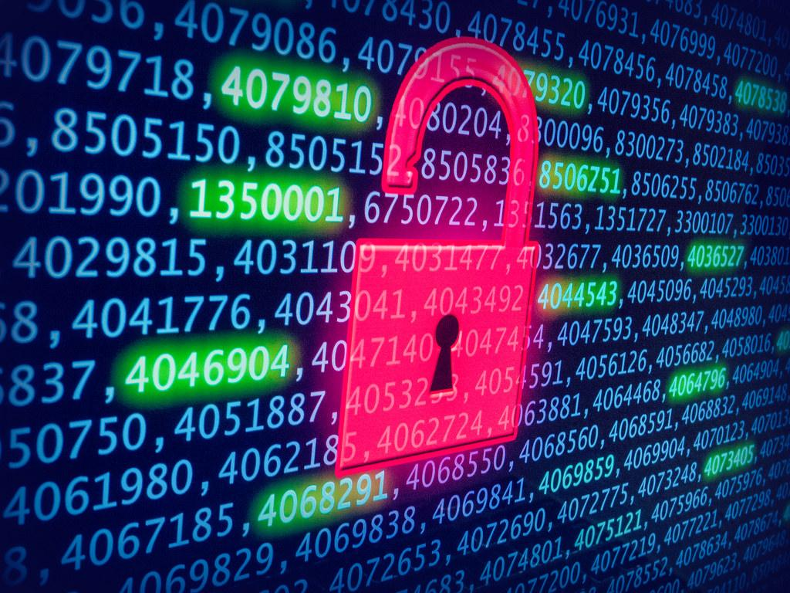

Project Overview
Assure continued business operations.
Supply Chain is an integrating function responsible for linking major business functions and business processes within and across companies into a business model.
SCRM is the process of identifying risks, threats, vulnerabilities, and likelihood related to acquisition and provisioning of components:
Hardware
Software
Infrastructure
Notes:
SCRM refers to managing risks related to manufacturing and delivery supply chains.
The process of identifying supply chain risks, threats, vulnerabilities, likelihood, and determining the impact to develop mitigation strategies.

Slide 4
Traditional Design
Follow NIST's approach to Cyber-SCRM
Organization-wide: cybersecurity, supply chain management, acquisition/procurement, legal, engineering,
Risk Management Process: C-SCRM should be implemented as part of overall enterprise risk management activities.
Critical systems: identify systems and components that are most vulnerable and will cause the greatest organizational impact if compromised.
Notes:
Discuss insurance as a way to mitigating loss during recovery.
SCRM is very popular in government acquisitions, especially in the intelligence community.
Understand which data is critical, where it is, who has it, who has access to it, and who is responsible for it.
Institute for Risk Management (IRM, 2015) as "any risk of financial loss, disruption or damage to the reputation of an organization from some sort of failure of its information technology systems."
The ISO 27005:2008 defines information security risk as "the potential that a given threat will exploit vulnerabilities of an asset or group of assets and thereby cause harm to the organization" (BSI, 2008).
Integrate SCRM platforms with procurement and supply chain management (SCM) software systems including software for spend visibility, e-sourcing, purchase-to-pay, contract management and compliance.

Slide 5
Hyperscale Design
Follow NIST's approach to Cyber-SCRM
Organization-wide: cybersecurity, supply chain management, acquisition/procurement, legal, engineering,
Risk Management Process: C-SCRM should be implemented as part of overall enterprise risk management activities.
Critical systems: identify systems and components that are most vulnerable and will cause the greatest organizational impact if compromised.
Notes:
Discuss insurance as a way to mitigating loss during recovery.
SCRM is very popular in government acquisitions, especially in the intelligence community.
Understand which data is critical, where it is, who has it, who has access to it, and who is responsible for it.
Institute for Risk Management (IRM, 2015) as "any risk of financial loss, disruption or damage to the reputation of an organization from some sort of failure of its information technology systems."
The ISO 27005:2008 defines information security risk as "the potential that a given threat will exploit vulnerabilities of an asset or group of assets and thereby cause harm to the organization" (BSI, 2008).
Integrate SCRM platforms with procurement and supply chain management (SCM) software systems including software for spend visibility, e-sourcing, purchase-to-pay, contract management and compliance.

Slide 6
Hyperscale vs Traditional Design
SCRM Threats for U.S. Based Technology Companies
Foreign intelligence
Foreign Military
Corporations
Criminal Organizations
Terrorist Groups
Threats can be Adversarial or non-adversarial
Vulnerabilities can be internal or external
Cyber attacks can originate in the supply chain
Hackers often target the weakest link in the chain
Notes:
Rockwell Automation SCRM Threats
Rockwell’s reputation and financial value can be impacted by:
Intellectual property breach
Operation interruptions
Sensitive data custody breach
Threats can be either "adversarial" (e.g. tampering, counterfeits) or "non-adversarial" (e.g. poor quality, natural disasters);
Vulnerabilities may be "internal" (e.g. organizational procedures) or "external" (e.g. part of an organization's supply chain

Slide 7
Supply Chain Risk Management Challenges
Hardware Procurement and Infrastructure
Supply availability
Manufacturing disruption
Software Assurance
Manipulating software products
Notes:
Complete supply chain management of all activities.
Hardware procurement supply chain risks include supply availability and manufacturing disruptions.
Software assurance supply chain risks include manipulation by third-party companies responsible for the development or delivery of software.

Slide 8
Rockwell and SCRM Intent Manage Rockwell’s acquisition risks
Notes:
SCRM acknowledges that the origin of system components cannot always be controlled.
Business Operations
Infrastructure
Data
Include SCRM into Rockwell's security program.
Managing risks related to manufacturing and delivery supply chains.
Process to identify supply chain risks, threats, vulnerabilities, likelihood, and determining the impact to develop mitigation strategies.
Ensure controls are used to prioritize efforts.

Slide 9
Technical Details
Database
Integrate with website
Secure credential implementation
Input / Output validation
Use connectors
Make a table
Network
10.1.1.0/24
Gateway 10.1.1.1
Load Balancer 10.1.1.3
IIS1 10.1.1.4
IIS2 10.1.1.5
Database1 10.1.1.6
AD/DNS 10.1.1.7
Software Development
Authenticate with AD
Input / Output validation
HTML
1 Website with authentication
1 Page after log in
Show server status
Show the list of students
CSS

Slide 10
Team Roles | Team Members
Database Engineer | John Hong
Network Engineer | Troy Mateo
Management / Security | Antonio Santana
Developer Lead | Nicholas Gabble
Notes:
|

Slide 11
Demonstration

